Slide 1


Success On KickStarter
Success on KickStarter
Possible factors of success:
Most Funded (Website Filter Option)
Most Backed
“Successful”, “Failed” values in Status Column (Categorical)
Defining Success: funded percentage column >=1
(all or nothing, money focused)
CAUTION
Advantages:
Numeric → Allows refined analysis of success in addition to binary “Status”
Allow anomaly detection techniques on extremely successful projects (low funding goals?)
Best Length of time
Ideal Pledge Goal
Most Successful Types of Projects
Ideal Launch Month/Day/Time
Tools Used
value_counts(bins=20)->R.skew kickstarter['funded percentage']>=1000 kickstarter[kickstarter['funded percentage']>=1].status.value_counts()

Slide 2
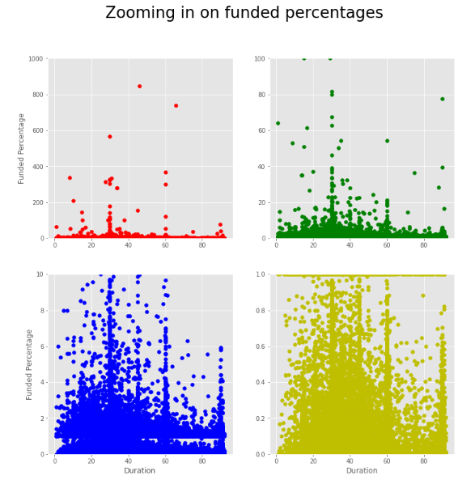
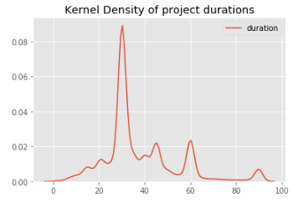
Best Length of time
Success On KickStarter
Success on KickStarter
Varying ax.set_ylim([0,i])
Green plot for identifying outstanding durations
Blue plot for outlier reduction (Typical project)
Yellow plot for nearly funded projects to verify durations
KDE to verify overplotting (missing out important duration values)
Need more checks to see dense indeed at success
Recommendations:
1st Choice: 30, 60
2nd Choice: 45, 90

Slide 3
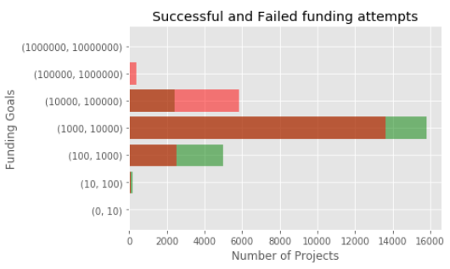
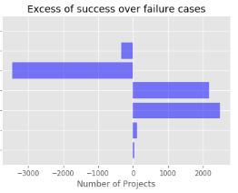
Ideal Pledge Goal
Success On KickStarter
Success on KickStarter
Split dataset:
success.goal (min: 0.01 max: 900000.0) failure.goal (min: 0.01 max: 21474836.47)
Range too big → Split to intervals
Recommendation:
Ideal range is $100 - $10000 (USD)

Slide 4
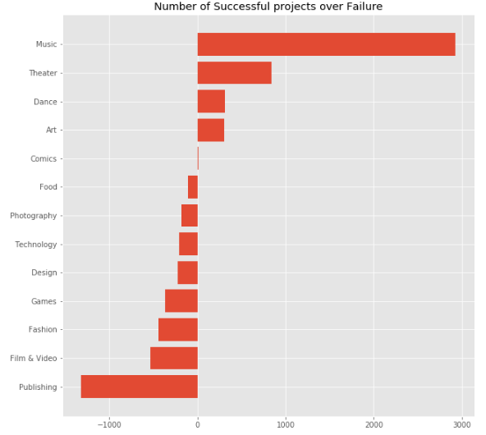
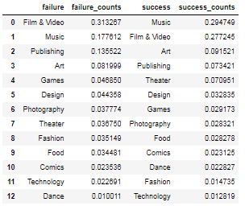
Most Successful Types
Success on KickStarter
Data Cleaning: Film &amp; Video vs Film & Video
Pivot Tables with Multilevel indexes can be used for detailed subcategory level analysis
Comparison to own Category
Comparison among Categories
Recommendations:
Music, Theater, Dance, Art
Question:
Why are there still so many projects of the Film & Video and Publishing type being launched when these 2 have the worst success: failure rate

Slide 5
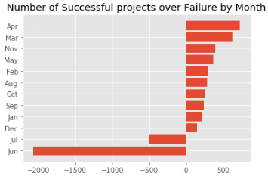
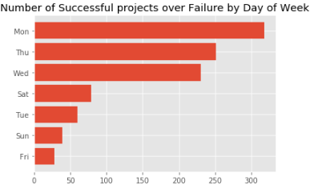
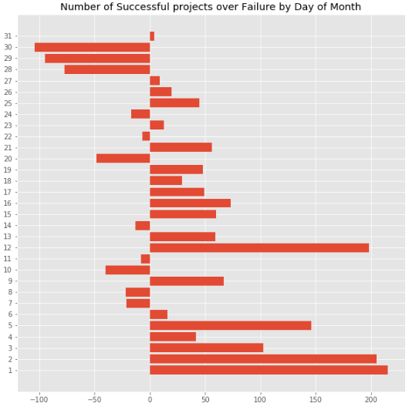
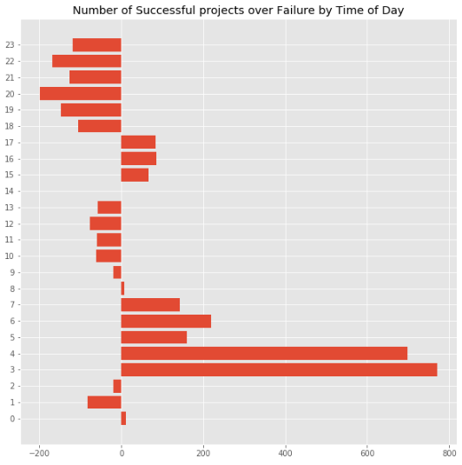
Ideal Launch Month/Day/Time
Success On KickStarter
Success on KickStarter
Parse Funded Date Column to extract values
Check Timezone of data!
Hypothesis:
6-11pm
People are tired
3-7am
Replace 6-11pm projects from last night, people wake up to these
More plausible if all funded dates are local time
Recommendations:
Month: Apr, Mar
Day of Week: Mon
Day of Month: First 5 days
Time of Day: 3-7am

